Slide 1
INTERNATIONAL STUDENT ASSISTANCE
Submitted by-:
Amol Singh
Simran
Pardeep Kaur
Ajay Sharma
Nimish Singla

Slide 2

Problem Description
Almost every international student, who comes to Canada to study, faces a lot of problems in the beginning
Finding Accommodation
Searching routes to college
Searching places like nearby supermarkets, restaurants, service centers etc.

Slide 3
SYSTEM CAPABILITIES
The System will:
Collect, store and secure user information (basic data)
Collect data of rental information from different people.
Collect information about various supermarkets, colleges, restaurants and transportation services(such as open hours, routes, official websites) using GPS(Google API)
Collect, Store and secure payment information.

Slide 4

SYSTEM BENEFITS
The deployment of this system will provide following benefits:
User will be getting a unique platform for different kind of services
Users will get collaboration of different apps in a single app.
Students can know about the important routes and buses operating around the city.
It will allow room provider to upload room features, advertise his/her room and also customize them to attract students.
App will support and help students in settling down easily.
App will increase the morale of students who fell alone and helpless in new country.
Students can easily know about the popular and important places nearby.

Slide 5
SUBSYSTEMS
ACCOUNT SUBSYSTEM (LOGIN AND REGISTERATION)
SEARCH LOCATION SUBSYSTEM
SEARCH ACCOMODATION SUBSYSYTEM
CONFIRM ACCOMODATION SUBSYSTEM (Payment)
CCOMODATION AVAILIABILTY SUBSYSTEM

Slide 6
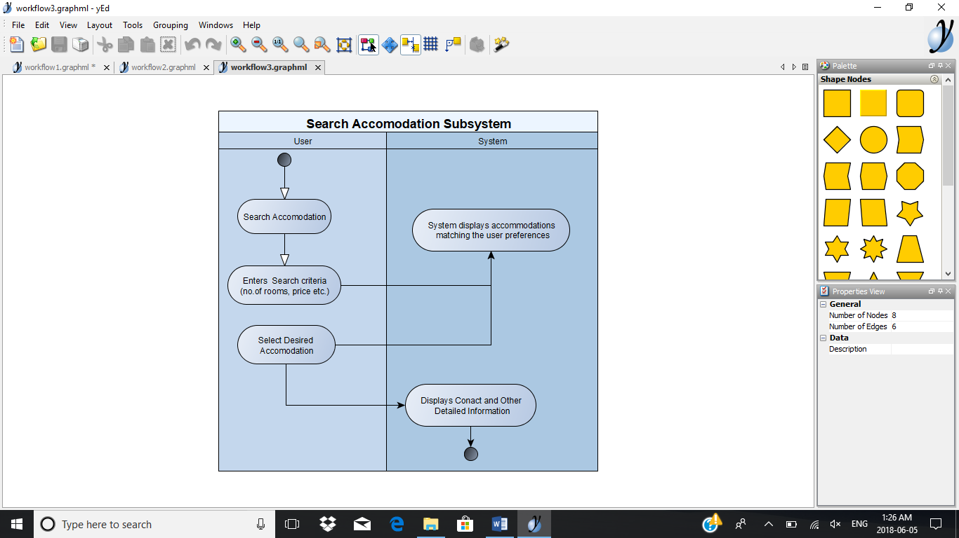
SEARCH ACCOMMODATION SUBSYSTEM
User taps on “Search Accommodation”
System prompts user to enter his preferences (e.g. no. of rooms, price range, location, accommodation type)
User provides the information requested
System displays accommodations matching the user preferences.
User selects the desired accommodation
System displays contacts information of the accommodation provider.

Slide 7
USE CASE OF SEARCH ACCOMMODATION SUBSYSTEM
Goal use case name | Actor(s) | Brief description | Priority(H,M,L)
Search Accommodation | Student | Actor tap on Search Accommodation. Actor provides preferences (Area, Price Range etc.). System analyses the information. System shows Available Accommodations on map. | H
Add Location | Accommodation Owner | Actor taps on Add Location. System asks for Information about the location (Name, Address etc.). Actor provides the information. System adds the location to the map database. | M
Check Reviews | Student, Accommodation Owner | Actor taps on Check reviews. System displays all the reviews from other users. | L

Slide 8
USER STORIES OF SEARCH ACCOMMODATION SUBSYSTEM
Search Accommodation-
USER STORY- As a student, I want to search accommodation so that I can find a place of my choice.
ACCEPTANCE CRITERIA:
The user should be able to search an accommodation.
Location and price range information should be collected.
Accommodation according to the user’s preferences should be displayed to the user.
Add Location-
USER STORY- As an accommodation owner, I want to add location of my place to the application so that people who are looking for accommodation can find it.
ACCEPTANCE CRITERIA:
The user should be able to add location of the accommodation.
Information about the owner and the location should be collected.
The data should be saved and displayed to the maps.

Slide 9
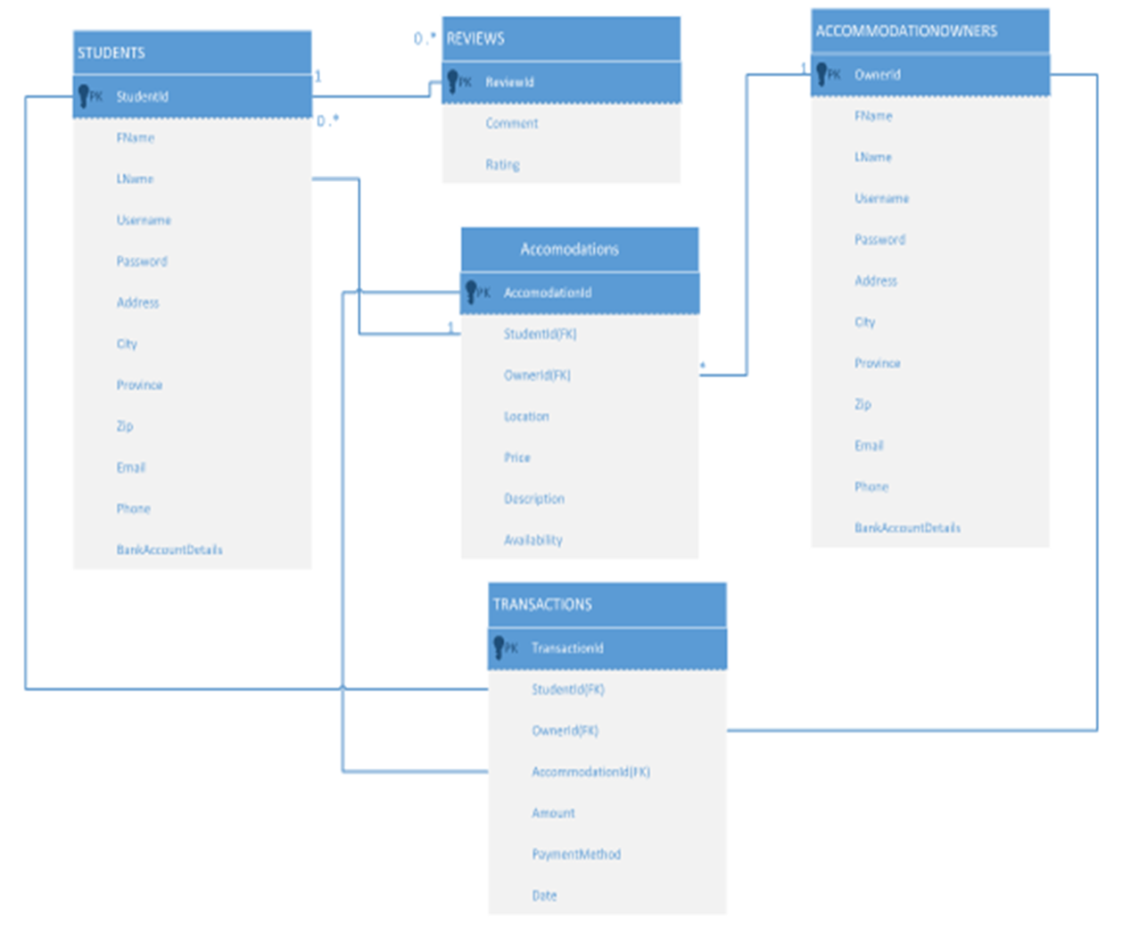
DOMAIN CLASS DIAGRAM

Slide 10
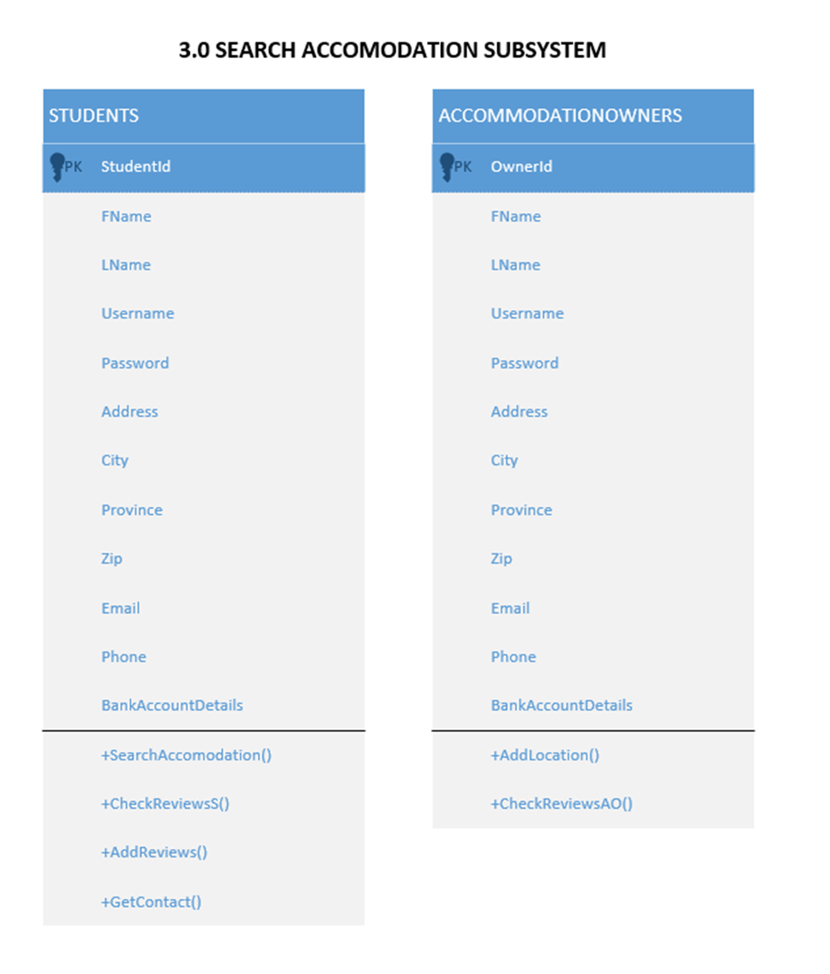
DESIGN CLASS OF SEARCH ACCOMMODATION

Slide 11
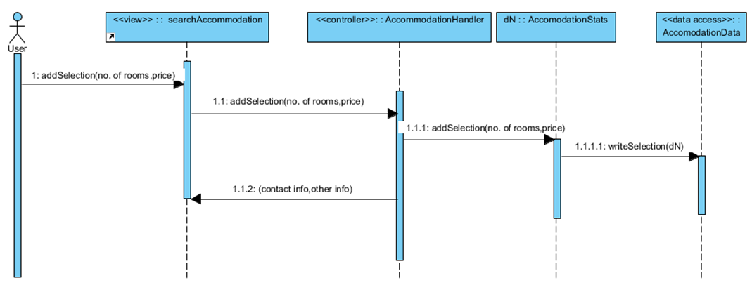

SEQUENCE DIAGRAM OF SEARCH ACCOMMODATION SUBSYSTEM

Slide 12
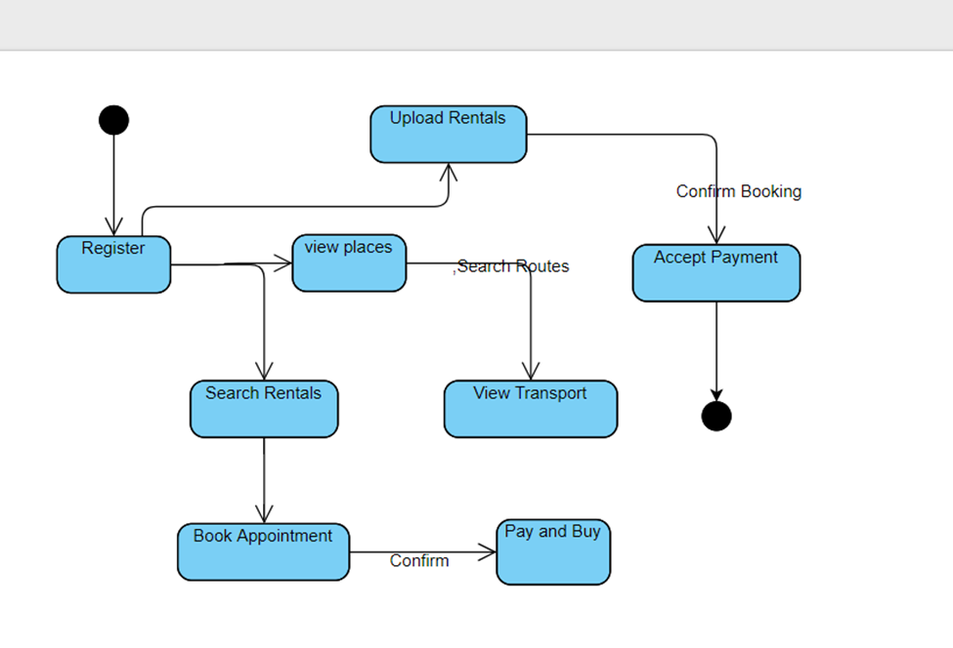
STATE MACHINE DIAGRAM

